Slide 1
foreach test on branch
commit 8e575fc0245e564e427f6fec62d3a72f524ff08e (HEAD -> non_contiguous_index_queue, origin/non_contiguous_index_queue)
left graph: test on branch
right graph: old test

Slide 2

left graph: test on branch right graph: old test

Slide 3
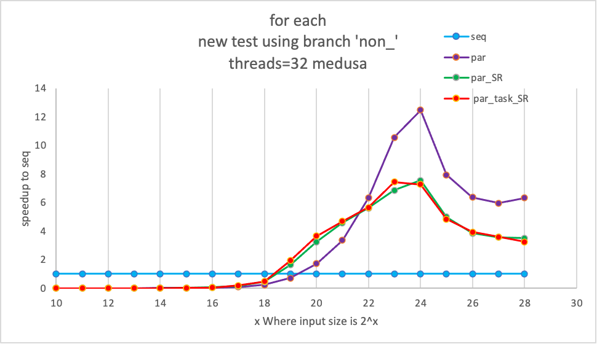

Slide 5
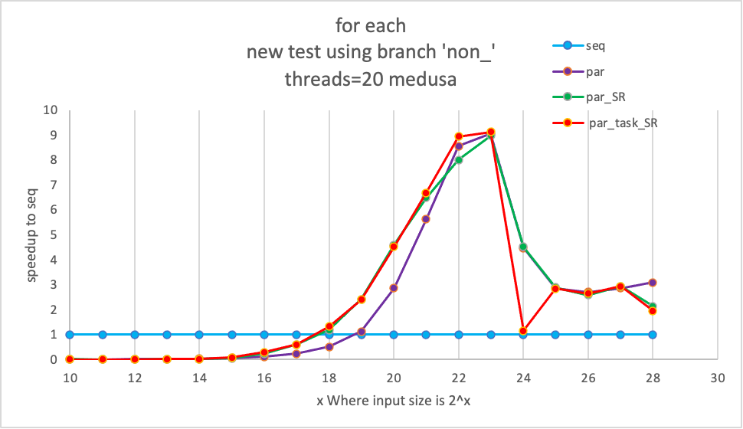

Slide 6
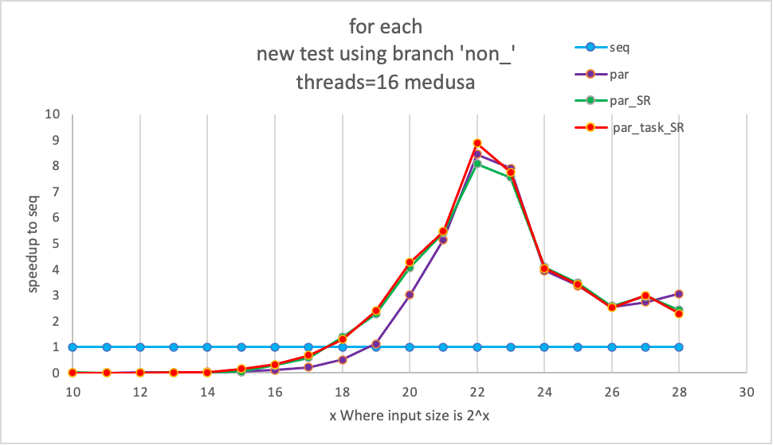

Slide 7
